Slide 1
TakenMind Data Analytics Internship Project
Proof of Concept - Employee Attrition

Slide 2
Objectives
Introduction
Methodology
Reasons employees are prone to leave?
What types of employees are leaving?
Which employees are prone to leave next?
Insights and Recommendation

Slide 3
Methodology
In order to proffer solution to company X Attrition Problem, the following steps are taken
Relationship between variables are identified
Identify 2 highest and 2 lowest causal variables of Employee Attrition
MultiVariant Analysis
Bi – Variant Analysis
Insights and Recommendations

Slide 4
Reasons Employees are Leaving?

Slide 5
Types of Employees that are leaving and those Prone to leave soon

Slide 6
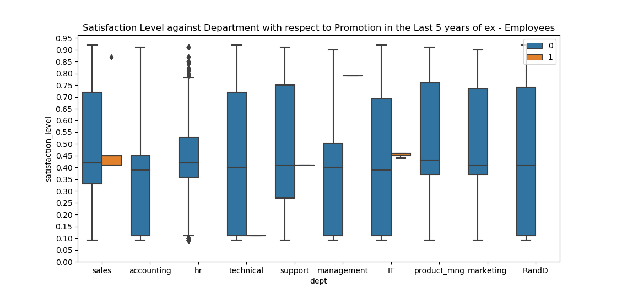
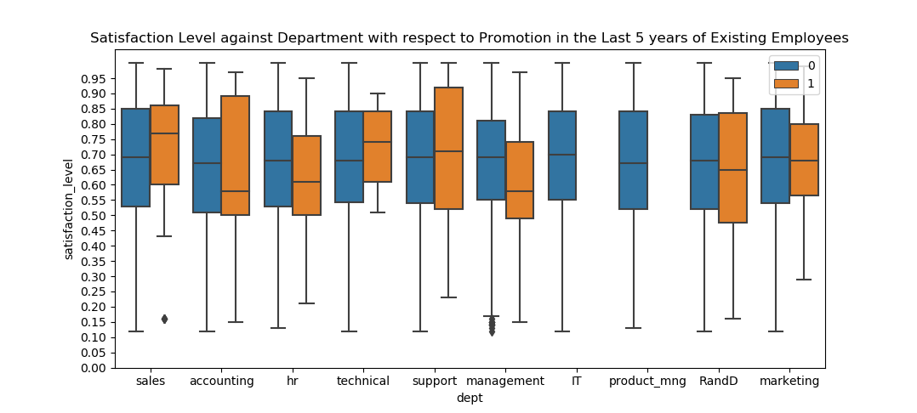
Multi – Variant Analysis – Chart 2

Slide 7
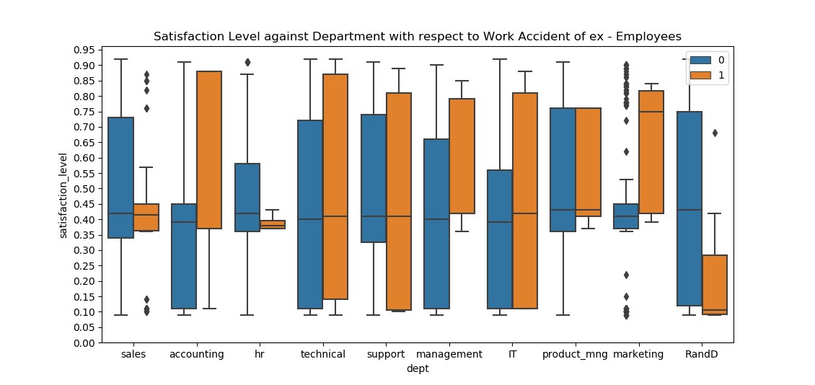
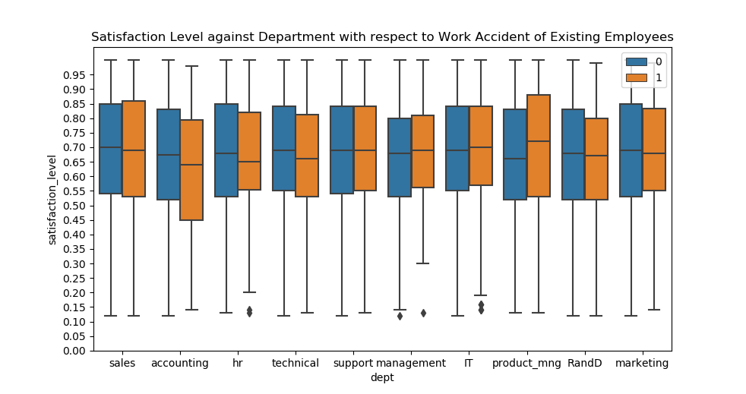
Multi – Variant Analysis – Chart 3

Slide 8
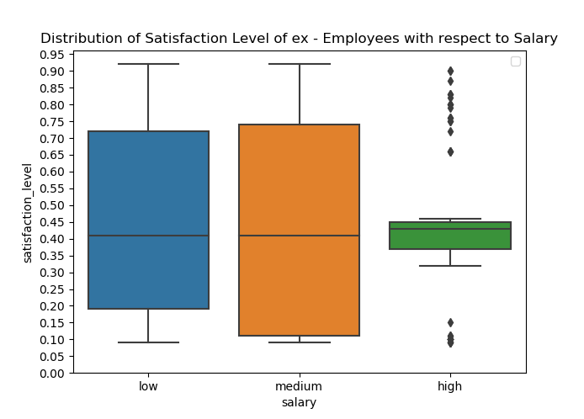
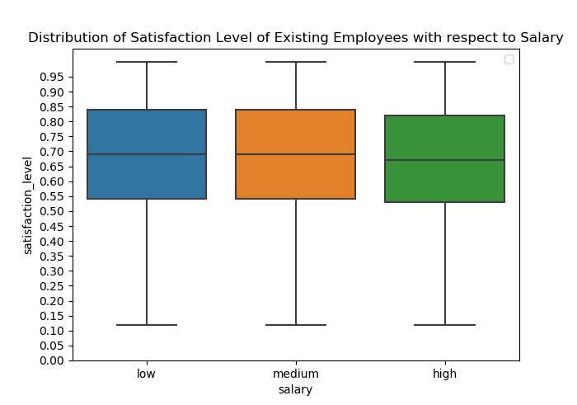
Bi – Variant Analysis – Chart 4

Slide 9
Insights and Recommendation
From chart 1, there exists a relationship between ex – employees who had NO promotion and ZERO work accident in their last 5 years and had a satisfaction level of an average of 45% and their last evaluation ranging between 40% to 50%.

Slide 10
Insights and Recommendation
Upon further analysis, it can be gathered from chart 2 that 98% of ex – employees that left had NO promotion in their last 5 years with 65% of them having a satisfaction level of 45%. Comparisons and analysis of existing employees shows that 18% of them are already displaying the same pattern i.e. 45% satisfaction level.
Recommendation: Incentives and strong measures should be taken to ramp their satisfaction level so as to prevent attrition.

Slide 11
Insights and Recommendation
Upon further analysis, it can be gathered from chart 3 that 95% of ex – employees that left had ZERO work accident with 67% of them having a satisfaction level of 40%. Comparisons and analysis of existing employees shows that 75% of them have ZERO work accident with satisfaction level of 55% and above. In order to prevent attrition of the remaining 25%, the recommendation below must be adhered to.
Recommendation: Improving the benefits of those involved in work accidents and those not involved in work accident should be given more incentives as well as a Accident – Free Reward System.

Slide 12
Insights and Recommendation
Upon further analysis, it can be gathered from chart 4 that 99% of ex – employees that left had high salaries but they still had satisfaction levels of 35% to 40%. Comparisons and analysis of existing employees shows that 25% currently have satisfaction levels of 50% and below, despite their high salaries.
Also, 50% of ex - employees with low and medium salaries have satisfaction levels of 40%. By comparison with existing employees, 25% of them fall in the category of those with 40% satisfaction level. In order to prevent attrition of these workers, the recommendation below must be adhered to.
Recommendation: Improved compensation in form of holidays, leave allowance etc. should be given to those with high salaries while those having medium and low salaries should have their salary scheme reviewed upwards.

Slide 13
Thank You TakenMind

